Slide 1
ECE 313: PROBABILITY WITH ENGINEERING APPLICATIONS
Fall 2023
Prof. Eric Chitambar
Lecture 1

Slide 2
Welcome!
Course website: https://courses.grainger.illinois.edu/ece313/fa2023/
Office Hours (see website for options)
Personal office hour: 1-2pm every Friday over Zoom, or by appointment
Message board and course notes on Canvas.
Homework posted on Canvas every Friday (or sooner).
Homework submitted through Gradescope on Canvas every Thursday by 5PM. The first HW is due 8/31.
No late HW accepted. The two lowest HW scores will be dropped.
Exam 1 (9/25 @ 7-8:15 pm); Exam 2 (10/30 @ 7-8:15 pm);
Apply for DRES accommodation at https://cbtf.engr.illinois.edu/cbtf-online/students/dres.html

Slide 3

The Monty Hall Problem
You are on a game show. Randomly hidden behind one of three doors is a car.
You choose one of the doors.
The game show host opens one of the doors you didn’t select and which doesn’t have the car.
You are given the option to change your selection.
A
B
C
Which of the following is true (assuming you want to win):
It is better for you to change your guess.
It is better for you to keep your guess.
It makes no difference whether you change your guess.

Slide 4
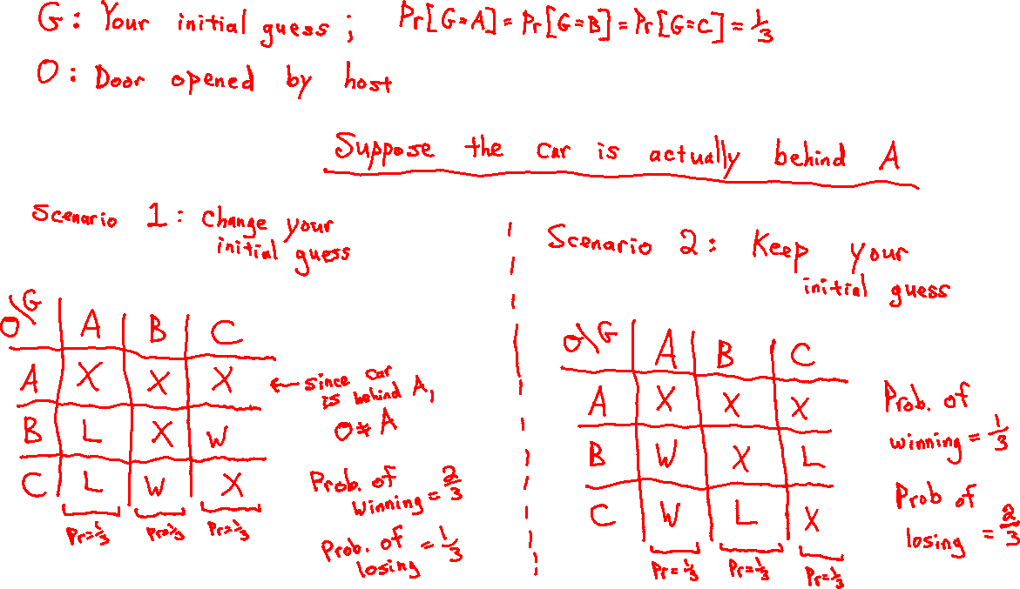
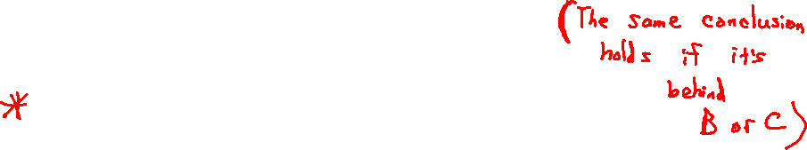

Slide 5
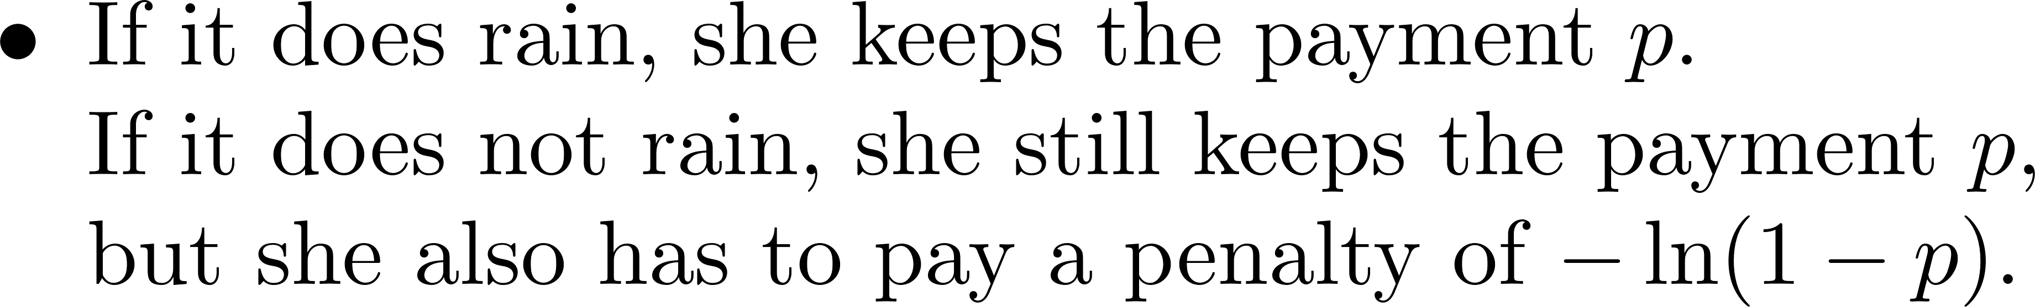
The Weather Forecasting Game

Slide 6
